Slide 1

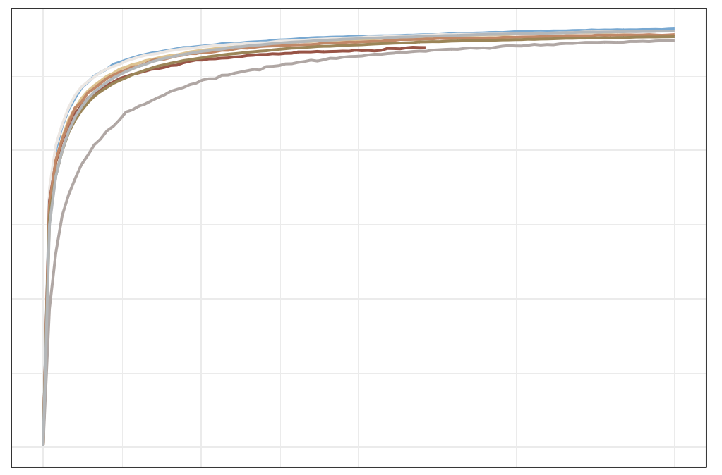
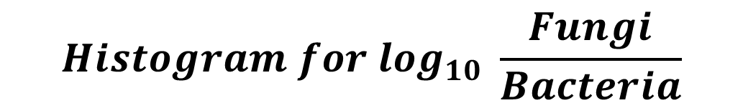
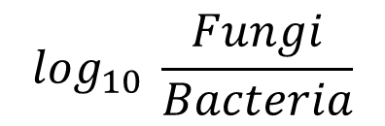
a
$$Histogram for \log_{10} \frac{Fungi}{Bacteria}$$
10
Histogram for log₁₀ $Fungi$
10
median = 4.31
median = −2.80
Percentage
8
8
6
4
Percentage
2
6
0
1
2
3
4
5
6
Histogram for log₁₀ Bacteria
8
median = 7.19
4
Percentage
6
4
2
2
0
4
5
6
7
8
0
−6
−5
−4
−3
−2
−1
$$\log_{10} \frac{Fungi}{Bacteria}$$
b
c
Sample sequence quality control
2,052 samples
filter abnormal
patients
1,935 samples
filter none
stage patients
1,919 samples
400
filter the
high-Fungi
sample (> 1% )
1,836 samples
filter the low-alignment-reads sample (< 1M )
1,837 samples
PCR free
chao1
2014_ZellerG
2015_FengQ 2016_VogtmannE 2019_ThomasAM 2019_WirbelJ 2019_YachidaS 2017_YuJ
2021_YuJ
Suspected contamination samples filtering
200
1,817 samples
filter the
low-Fungal sample (< 0.01% )
1,739 samples
filter suspected of bacteria contamination
(1 species> 50%)
1,670 samples
Low-fungal sequence depth samples discarding
0
1,329 samples
filter low-fungal
sequencing depth samples ( < 10k)
1,625 samples
filter suspected of fungal
contamination
(1 species> 50%)
0
5000
10000
15000
20000
Sequencing Depth in Fungi
S figure 1

